Slide 1
GENERAL GOVERNMENT 2024-2025 BUDGET
As proposed by the Town council
Anthony J. Salvatore –Town Manager
James Demetriades – Mayor
Town Council:
Al Waters – Deputy Mayor
Julia Aurigemma
John Henehan
Paula Luna
Stacy Dabrowski
Brian Bonneau

Slide 2
Town of Cromwell
The challenge of town government is to provide an improved quality of life and plan for the future. The Town of Cromwell prides itself in providing quality services, public safety and cultural and enriching programs. The Town’s top priority is to enhance the community while maintaining a high level of services with affordability.
I want to thank all of our department heads and their staff for their dedication and commitment to our Town. They have helped raise service levels while managing costs.

Slide 3
Budget Summary
2021-22 Adopted Budget
$17,902,270 0.50% Increase
2022-23 Adopted Budget
$18,556,627 3.66% Increase
2023-24 Adopted Budget
$18,262,011 (1.59%) Decrease

Slide 4
Budget Highlights 2024-25
Total General Government budget = $19,893,215
(as approved by Town Council)
8.93% increase (5.58% without Capital/Non-Recurring), or $1,631,203 over the 2023-24 budget, including Capital/Non-Recurring requests
CNR historically funded by General Fund fund balance
2024-25 requests = $611,571; 2023-24 requests = $0
$451,000 funded through ARPA (American Rescue Plan)
Employee wages and benefits = 73% of total budget

Slide 5
ADDITIONAL HIGHLIGHTS
Wages increase was 6.52% due to contractual obligations.
Employee Benefits
Employer pension contributions
Municipal Employee Retirement System: employer contribution increasing from 21.72% to 24.10%.
Health Insurance -negotiated a 6% increase down from 12%.
Increase in Actuarial Determined Employer Contribution to reflect change in mortality tables.

Slide 6
ADDITIONAL HIGHLIGHTS
Public Safety
Accreditation
State of Connecticut Tier 1 Accreditation.
Working towards State of Connecticut Tier 2 Accreditation.
Full State Accreditation must be achieved by 2026.
Adding a Sergeant January 2024 in order to fulfill the Administrative Sergeant position which was approved in FY22
Continue to increase community interaction with officers and enhance social media presence.

Slide 7
ADDITIONAL HIGHLIGHTS
Public Works
Building Maintenance
Electrical improvements throughout Town Hall and safety upgrades due to OSHA Inspection. ($30,000)
Park Maintenance
Took over Board of Education irrigation, preventative maintenance on Tennis Courts and working to improve the condition of the athletic fields.
Utilities
All Town facilities have been metered by the Water Department.
Maintenance and repair on streetlights.

Slide 8
ADDITIONAL HIGHLIGHTS
Elections
Increase due to Early Voting $34,805
Central Services
Increase due to increased hours for on-site dedicated IT service, technology increases and the cost of a Local Backup System
Youth Services
Creating a Part-Time Case Manager to supplement the Juvenile Review Board Grant to meet the increased cases and workload of the Juvenile Review Board
Creating an Opioid Prevention Specialist using the opioid settlement fund.

Slide 9
2024-25 General Government Budget by Department

Slide 10
Impact on Budget
 | Change from Prior Year | Compared to Prior Year | % of Total Budget Increase
General Government | $704,854 | 21.25% | 43.2%
Boards & Comm. | $763 | 1.4% | .04%
Public Works | $116,313 | 2.42% | 7.1%
Public Safety | $379,482 | 9.26% | 23.26%
Human Services | $30,435 | 3.9% | 1.9%
Library/Recreation | $55,046 | 5.5% | 3.4%
Employee Benefits | $344,309 | 8.20% | 21.10%
Total | $1,631,203 | 8.93% | 100.00%

Slide 11
OTHER ITEMS
TOWN MANAGER CUTS
Public Safety
Lieutenant position
Building Inspection Department
Staffing for additional inspections
Public Works
Various Divisions
Assessor
Increase pay level for Assessor
STILL ON WATCH LIST
Public Works
Solid Waste Disposal
Utilities-electricity rates, additional streetlights
Major equipment or facility repairs due to age
Legal Fees
Dependent on status of existing & future court cases

Slide 12
REVENUE
Revenue other than Taxation
State Aid
Governor’s proposal for State Aid to Cromwell basically reflects level funding, with a slight increase in Education Cost Sharing (ECS) grant.
Other General Fund revenue sources
No significant changes anticipated.
Grand List reflects a slight increase
~.30% increase

Slide 13
CAPITAL IMPROVEMENT PROGRAM
Capital Improvement Program
Charter requires that the Town Council to adopt a 5-year CIP every year
Charter also requires CIP to be reviewed with Operating Budget
Proposed funding through General Fund fund balance
$611,571 Capital requests approved
$2,443,121 Capital items requested
Possible other sources of revenue identified for some requests
ARPA, Special Revenue Fund, General Fund, State Bonding Grants

Slide 14
CAPITAL IMPROVEMENT PROGRAM
Items Proposed for Capital/Non-Recurring Fund
Planning & Development - $100,000 Complete Streets Plan
Finance/Computer - $23,000 Server
Public Works - $218,653
$85,000 Leaf Vacuum (Highway)
$59,653 Flat Body & Brine (Highway)
$15,000 Replacement Pickup Utility Body (Building Maintenance)
$59,000 4x4 Pick-Up Truck (Parks & Grounds)

Slide 15
CAPITAL IMPROVEMENT PROGRAM
Items Proposed for Capital/Non-Recurring Fund
Board of Education Totaling $269,918
$51,000 CHS-Service Receptacles Lacking Roof
$24,870 WIS-Replace Water Heater
$12,037 WIS-Replacement of Split System
$16,511 ECS-Services Receptacles Lacking Roof
$15,000 CHS-Refurbish Weight Room Floor
$25,000 CHS-Refurbish Gym Floor
$12,000 CHS-Driveway Light Pole Repair
$15,000 WIS-Underground Oil Tank Repair
$27,500 ECS-Classroom blinds Replacement (phase 1 of 4)
$22,000 ECS-Replacement of Roof Exhaust Fans
$49,000 ECS-Replace Ceiling Tiles for 6 Classrooms

Slide 16
AMERICAN RESCUE PLAN
Town Allocation: $4,095,660
Final Rule issued by U.S. Treasury December 2021
Town Council approved using the Revenue Replacement category (standard allowance of up to $10M)
Funds can be used for provision of government services
Greater flexibility and simplified reporting
Projects include:
$311,000 Road Improvements
$140,000 Police Vehicles

Slide 17
AMERICAN RESCUE PLAN
Funds must be committed by the end of the calendar year 2024 and spent by end of calendar year 2026.

Slide 18
AMERICAN RESCUE PLAN RESTRICTIONS
Funds cannot be used to directly or indirectly offset tax reductions or a tax increase; cannot be deposited into a pension fund.
Caution: Due to the one-time nature of these funds, it is not advisable to create new programs, add-on to existing programs that require an ongoing financial commitment or staffing.

Slide 19
DEBT SERVICE
2023-24 BUDGET
$3,131,059
2024-25 BUDGET
$3,238,994

Slide 20
Debt Service – Overview
Legally required to make annual payments on existing bond obligations as determined at issuance.
Three Bond Issues Outstanding:
2016: Roads, Facilities, Equipment
2017: Refunding (refinancing) 2008, 2010 series bonds
2019: Public Works Facility
Total Increase $107,935 (3.45%)
Continued pay-down of existing debt
2013 Roads, Facilities, Equipment debt and refunding debt paid off in FY23
Increase includes $1,920,000 in interest for short-term financing for the New Middle School

Slide 21
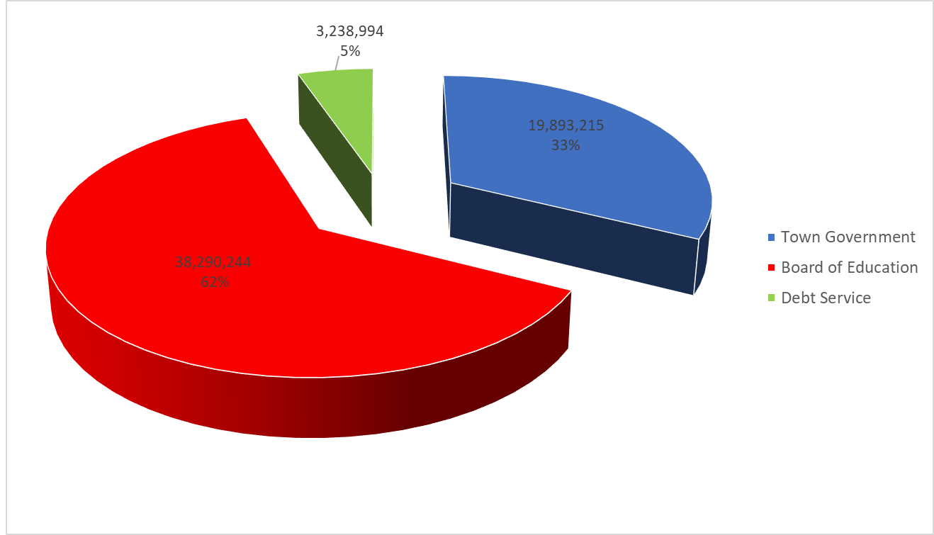
ALLOCATION OF TOTAL 2024-25 BUDGET

Slide 22
SUMMARY
The budget, as approved by Town Council, is $2,181,970 less than what was requested by the departments, including the capital improvement requests, while maintaining programs and services that the community has come to expect.
This budget provides funding to maintain and improve our infrastructure and capital assets.

Slide 23
SUMMARY
Global situations, supply chain issues, and inflation have impacted the Town’s ability to purchase materials, supplies and services.
Town mill rate has been relatively stable over 20 years, fluctuating from 26.30 mills in 2003-04 and 26.16 mills in 2023-24.
Low = 26.16 High = 31.68
Five revaluations

Slide 24
SUMMARY
As always, this budget was created with every effort to maintain programs and services to the community with the intention of keeping the tax impact at a minimum.

